Slide 1



THE 1ST STUDENT-ATHLETE AMERICAN SCHOOL OVERSEAS

Slide 2


SIP SCHOOL OF EXCELLENCE
This all-inclusive student-athlete school program provides an advanced environment, similar to those found at the top professional soccer clubs in the world. The full-time school provides players with a full ten months of consistent, high level development, training, and education. This soccer-specific program includes a daily regimen of individual and group training; focus specific conditioning (both mentally and physically), speed and strength development; and an ongoing, personalized assessment and feedback specific to the individual’s progress.
To ensure the development of each and every student, person and player, the S.I.P’s School of Excellence is founded upon the principles of leadership, determination, respect, teamwork and commitment to create an environment that is conducive for all players to maximize their greatest abilities on the pitch, and in life.
The staff of teachers and coaches will impart a confidence within each student-athlete to fashion a dream goal, while equipping them with the necessary tools to obtain the reality of their every dream.
In our unique setting, our student-athletes are surrounded by co-athletes who are common in the same bond, drive and ambition, that they share, to pursue a career in soccer; be it at the college level or beyond to the professional level; and are therefore able to shape a strong academic, athletic, and social foundation; one that will cause each student-athlete to excel for beyond the soccer field.

Slide 3

STUDENT LIFE
SIP SCHOOL OF EXCELLENCE is built on community, values, hard work and fearlessness. As an organization, we surround ourselves with individuals who have an innate need and desire to pay it forward.
Our flexible learning solutions help you to balance travel, sports and family with innovative general honors, Career and Technical Education.
With physical exercise being crucial to our children’s health and overall well-being, we feel that this program will be an added boast to their development while aiding them, in discovery, how to partner with others in being apart of a team reliance environment; as well as, fosters their own individuality discovery.
We encourage and support zestful living and engaging approach to maturity in taking ownership of their life here. They will be encouraged to make these independent decisions and choices, they are not without a team of adults that will guide, protect and counsel to ensure that each student-athlete has the necessary tools to guarantee success.

Slide 4


ACADEMIC CURRICULUM
SOCCER INTERNATIONAL PATHWAY is in exclusive partnership with a full-time US virtual public-school program that combines the best online and offline resources from leading educational publishers and curriculum specialist to deliver comprehensive, high-quality High School and College online education. Students will have the best resources at their fingertips, S.I.P School of Excellence students will explore and master all required core subjects for the High school students: language arts, mathematics, science, and social studies.
SIP School College program is your choice for higher education.
Developed by a team of leading educational experts, Great Basin College Online (GBC Online) curriculum is one of the finest, most comprehensive programs available anywhere. It integrates the best learning materials for world-renowned educational publishers, including both online and offline resources, for a well-rounded learning experience. The GBC Online curriculum experts constantly evaluate and update the online courses to deliver the most effective results and to align with the United States Standards. In support of their personalized approach GBC Online designed and offers a robust selection of core courses and an exciting array of electives to give students choice and flexibility.

Slide 5



Our Partnering Schools are Accredited in US and Internationally

Slide 6
SOCCER PROGRAM
SIP is a culmination of local Soccer clubs, and profesional coaches who have played and coaches at every level, in Europe. This allows SIP SCHOOL OF EXCELLENCE to offer a completely unique coaching and evaluation experience that is above any other.
This soccer, focus-specific program includes a daily régimen of individual and team training, games, soccer specific conditioning, speed and strength training and ongoing individualized assesments. This includes weekly mental conditioning, visión and awareness training, nutritional coaching and leadership sessions with a focus on life skills.
The predominant goal of SIP SCHOOL OF EXCELLENCE is to maximize each student-athlete’s potential and make a difference in their life and future.

Slide 7
























SOME OUR PARTERING BELGIAN CLUBS

Slide 8
www.soccerip.com

Slide 9


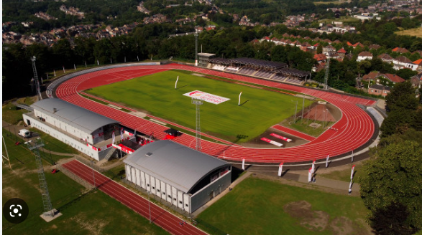
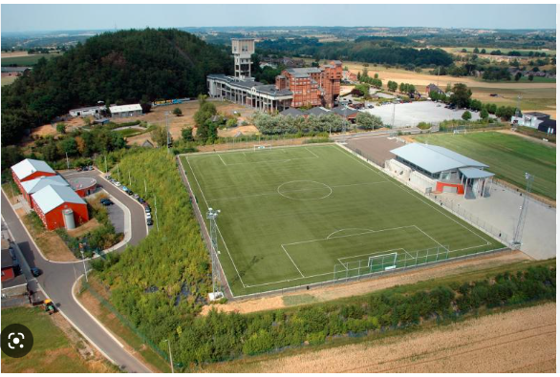

School Facility & location
Naimette-Xhovémont Football Complexe
CREF Blegny Football Complexe

Slide 10

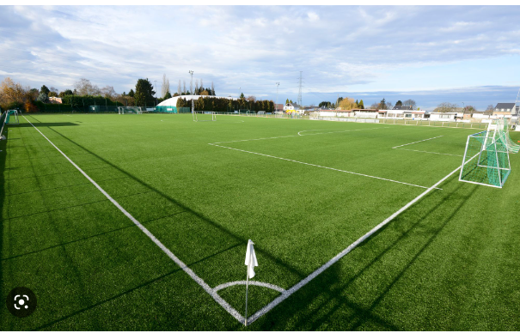
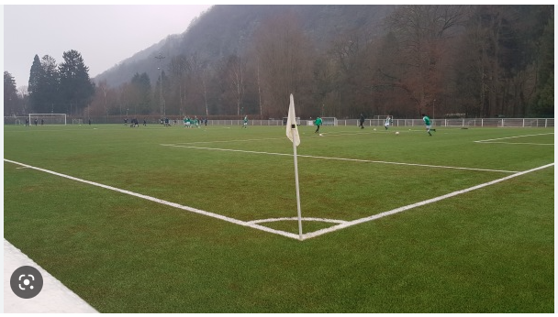

RSC Beaufays Football Club Field
Royal Aywaille Football Club Field

Slide 11
Tuition & Fee Structures
Boarding School Tuition fee is €25000/Year and includes:
• Full board: breakfast, lunch & dinner
• Meeting room/Relaxing hall
• Classroom room for laptops usage
• Free wi-fi
• Refrigerator and Microwave available
• Onsite Physiotherapy and Osteopathy treatment in case of injury.
• Laundry room
• Transportation to the soccer Fields

Slide 12
• Enrollment for College Courses up two classes
With French Lessons.
•Enrollment for High schoolers
With French Lessons.
•Enrollment in a local club.
•Full-Time Training Schedule.
•Guaranteed League Games
•Weekly Team Analysis of the games.
•Nutritional counseling.
•Quarterly report of the student’s progress.
•Advice of Experts in High Performance Psychology.
•Multicultural activities

Slide 13
Day School Tuition fee is €12000/Year and includes:
• Enrollment for College Courses up two classes
With French Lessons.
•Enrollment for High schoolers
With French Lessons.
•Enrollment in a local club.
•Full-Time Training Schedule.
•Guaranteed League Games
•Weekly Team Analysis of the games.
•Nutritional counseling.
•Quarterly report of the student’s progress.
•Advice of Experts in High Performance Psychology.
•Multicultural activities

Slide 14
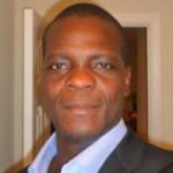
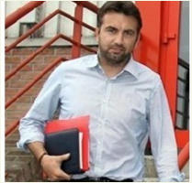

WHO WE ARE
Geoffrey N’Goran
Drector & CEO of S.I.P Global
Geoffrey played professionally in Belgium, Sweden, Holland, France, Finland, Germany, and America as well as internationally for the Ivory Coast National Team . He also pre-qualifies for the UEFA Coaching License because of the amount of professional games played in Europe. With over 17 years of high standard soccer experience. In addition Coach Geoffrey is also a Professional European Soccer Scout and he is the founder of InterProFootBall MGMT www.interprofootball.com
Eric Depireux
Director of Player’s MGMT
Eric played professionally in Belgium. With over 20 years of high standard soccer experience. Mr. Depireux hold the Belgium FIFA agent license and he currently serve as the director of S.I.P Global Players Management.

Slide 15

SOCCER INTERNATIONAL PATHWAY SCHOOL OF EXCELLENCE
CONTACT US AT:
SIP SCHOOLS GLOBAL
SIP SCHOOL USA OFFICE : 4010 Memory Lane, Raleigh NC 27604
Phone: +1 919 714 9291 WhatsApp/ +1 984-379-9200
SIP SCHOOL BELGIUM OFFICE: Rue Lambert le Bègue 12, 4000 Liege, Belgium
SIP SCHOOL FRANCE OFFICE: 83 AV HENRI BARBUSSE 59770 MARLY
EMAIL: info@soccerip.com
REGISTRATION: https://soccerip.com/application.htm
VISIT OUR WEBSITE : WWW.SOCCERIP.COM

